Slide 1
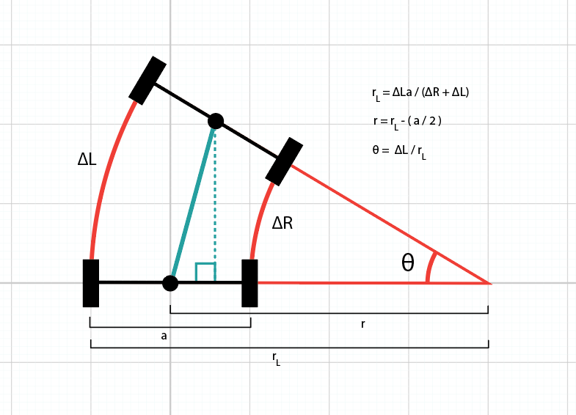
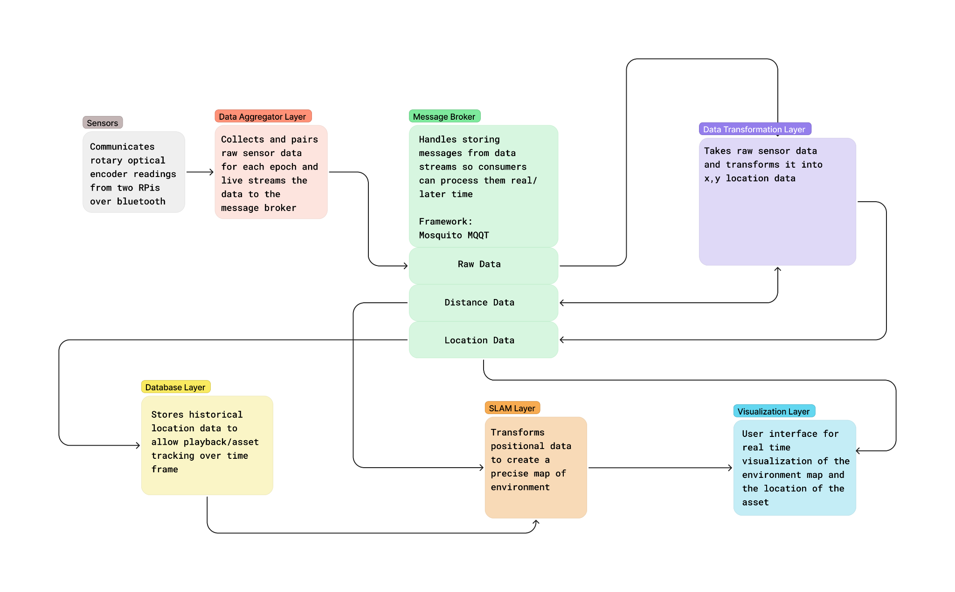

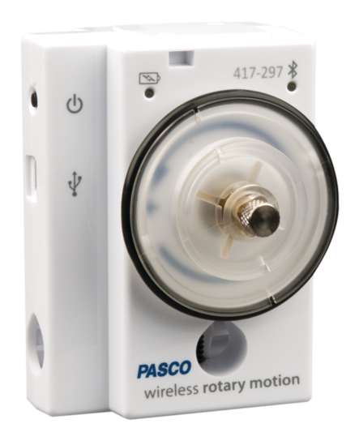
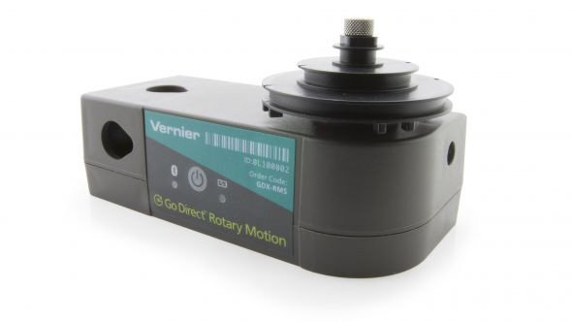





24-311
RoverMapper-Autonomous Terrain Mapping using Wheel-Based Rovers
Team members: Imanol Murillo, Luke Unterman, Mallika Lakshminaryan, Tashon Holmes | Faculty adviser: Dr. Nadeem Tamer
Problem Statement
There are indoor localization system but they can often be unreliable and irrelevant
Manual methods
Manual checks
Record keeping
Automated methods
Expensive RTLS systems (RFID tags, GPS)
CMMS
Our Design
We have 5 layers to our deign
Data Aggregation Layer
Data Transformation Layer
Visualization Layer
Database Layer
SLAM Layer
Theory
You can get the rotational motion from two wheels by using these formulas
Milestones
Understanding the previous system
Researching for compatible Rotary Optical Encoder sensors
Researching the drift of IMU and Rotary Optical Encoder sensors
Design for sensor attachment to wheel based systems
Implement new sensor into application
Research SLAM algorithms
Implement SLAM algorithms with LIDAR sensors and cameras
Design and Implement Database schemas
Additional UI enhancements
Our Solution
Using a Rotary Optical Encoder Sensor for more accurate readings
Have two sensors in mind to test which works better
Anticipate to have less drift
Anticipate to have more accurate readings
Implementing an autonomous mapping
Plan to use a SLAM algorithm
Implementing a database
Will be useful for storing historical information of the mapping
Values
The social benefit would be crucial
Health care
Warehouses
Motor Vehicle Industry
Transportation Industry
Asset Management Insutry

